Slide 1
Location and Price Analysis for Housing in Indonesia
Jonathan Tanone
April 2021

Slide 2
Introduction
Background
One of the most populous country
Analyst are optimistic in property demand growth in 2021
Problem
Too many information
Unable to transform it into insights
Interest
Providing a good starting point for property search
People who want to search for new property efficiently

Slide 3
Data Source
Lamudi (One of the most popular Indonesia listing website)
Foursquare (Venue Search)

Slide 4
Data Cleaning and Processing
Listing data scraped from Lamudi
Cleaning inconsistencies in format
Dropping locations that contains single values
Venue data from Foursquare
Requesting venues around the area with count limit of 100
Grouping by categories
Issues
Most of the data are from Java.
Reason: Education quality and Technological Penetration rate

Slide 5
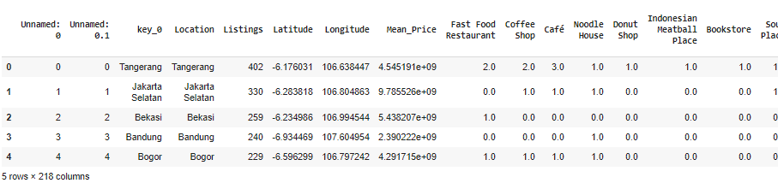
Data Frame after Cleaning and Processing

Slide 6
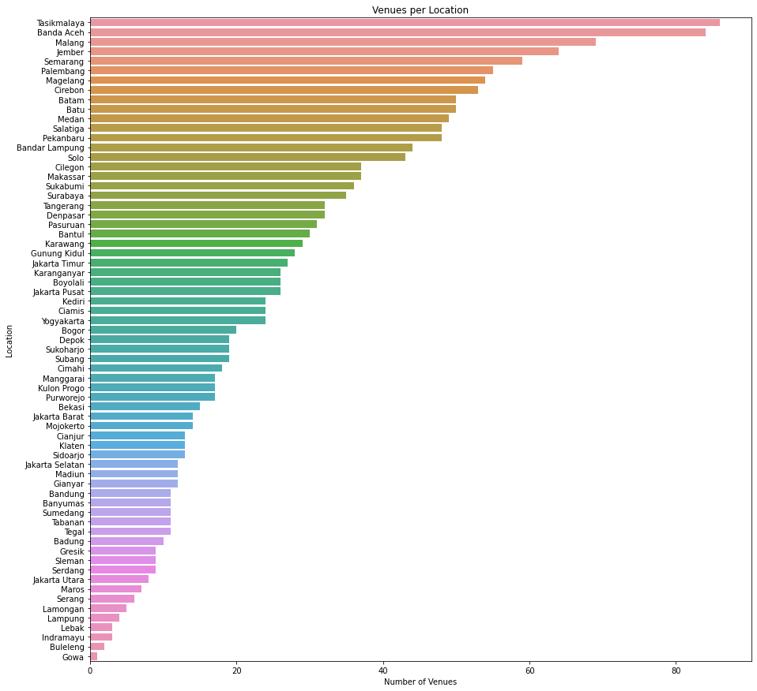
Venues per Location

Slide 7
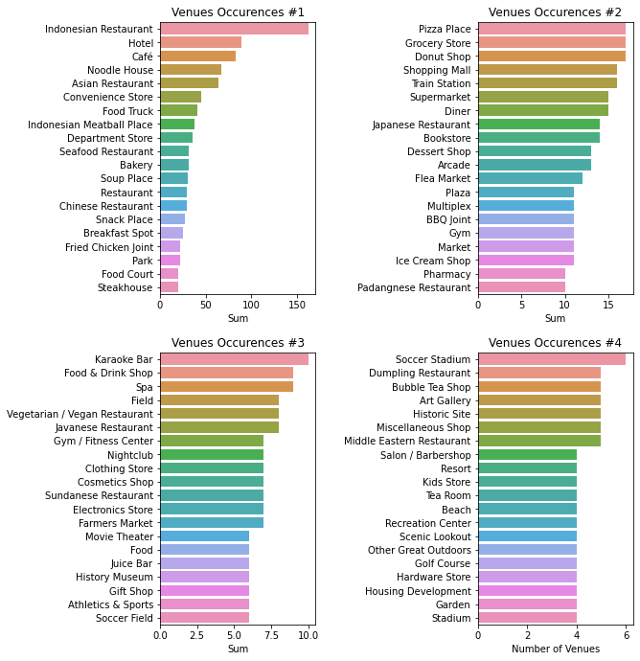
Venues Categorical Count

Slide 8
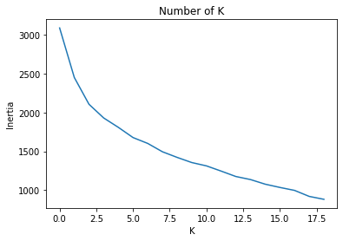
Clustering (Number of K)
Using inertia elbow method
Number of optimal K=8

Slide 9
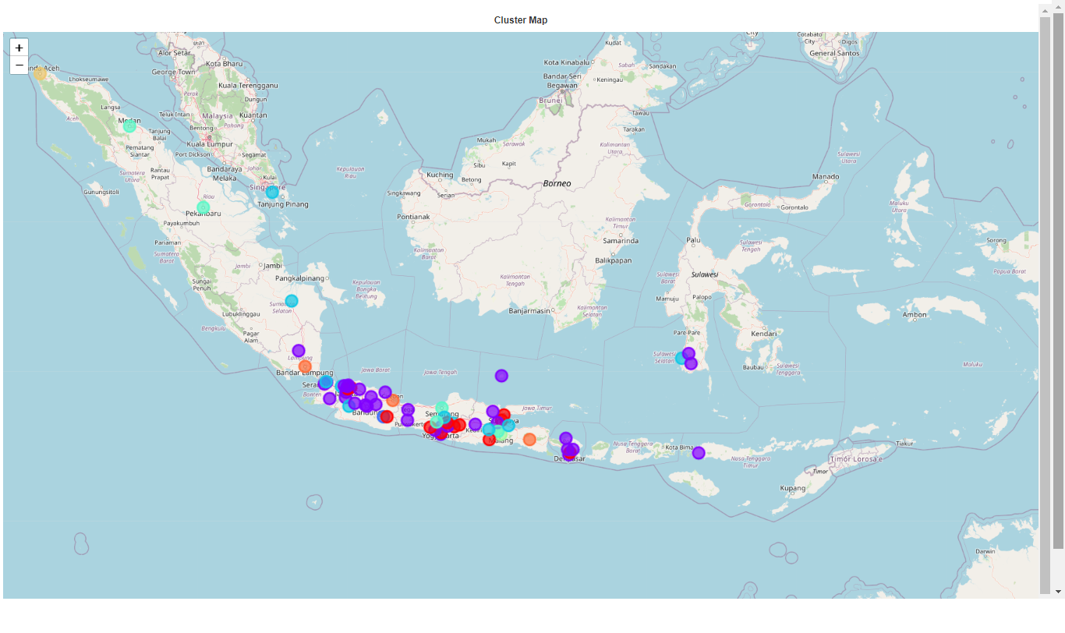
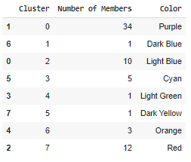
Resulting Cluster

Slide 10
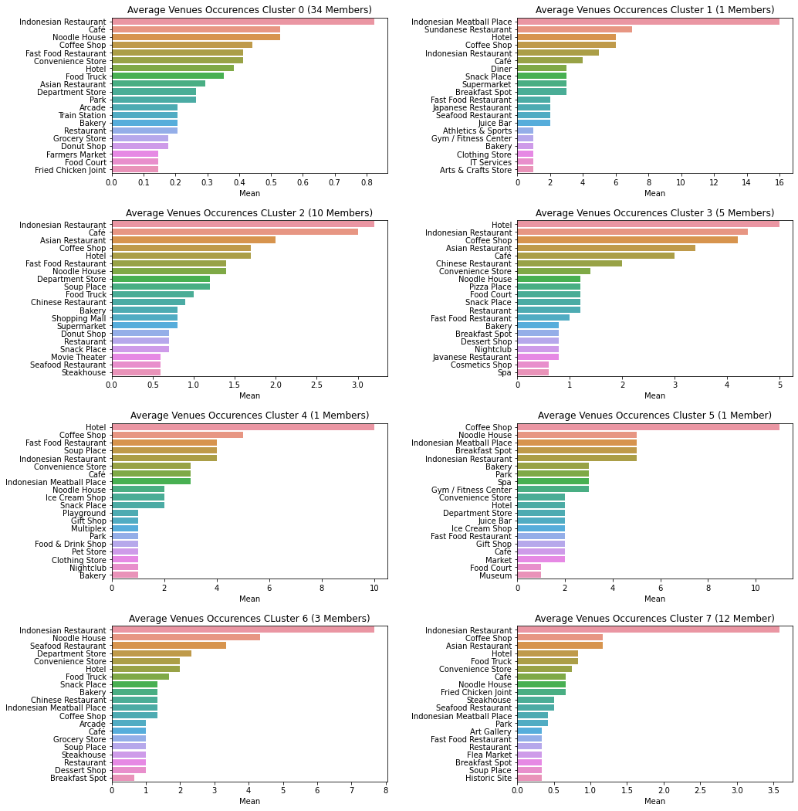
Venue Profile of each Cluster

Slide 11
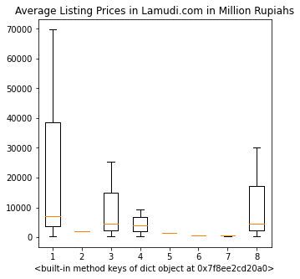
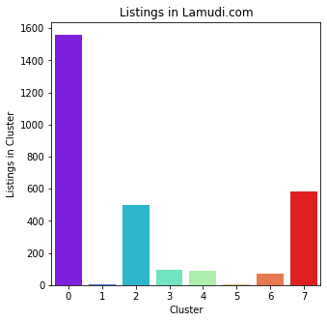
Average Prices and Numbers of Listings for each Cluster

Slide 12
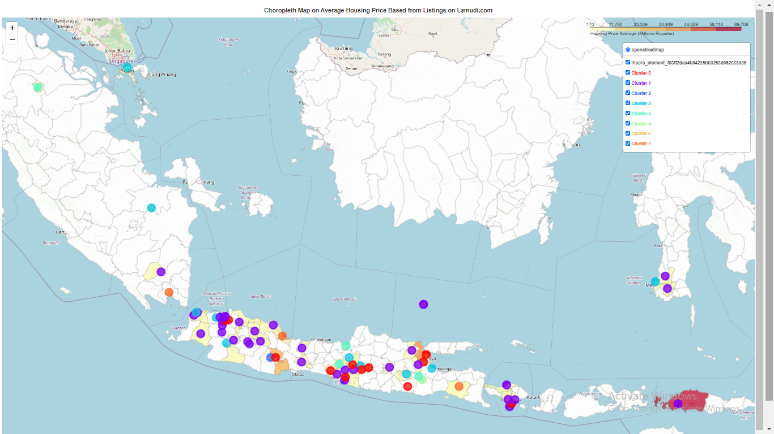
Choropleth Map

Slide 13
Conclusion
Succeeded to build a venue profile for each cluster
Visualizing the data to speed up user comprehension
Providing a good starting point for user in property search

Slide 14
Future Direction
Additional Data for areas that has not been analyzed
Unique cluster profile

